Slide 1
Strategies to prevent and reduce loss to follow up
India Hypertension Control Initiative
Training of Trainers
2019

Slide 2
Definition of missed visits & loss to follow up
Missed visits
“Individuals who did not return for care even once in a quarter, 3-6 months after registration.”
Lost to follow up
“ Individuals who did not return to care for 12 months”

Slide 3
Reasons for missed visits/lost to follow up
Health system
Drug stock outs
Higher proportion of missed visits in District hospital
Lack of field staff
Registered patients may be from far away places
No documentation in the card
Irregular availability of service providers
Unfriendly staff
Patient not informed about follow up visits
Side effects due to drugs
Disturbance to staff nurse due to unwanted calls from patients
Patient
Lack of awareness to come for follow up
Asymptomatic condition
Lack of perceived importance of regular treatment
Elderly patients and bed ridden patients
Distance between home and facility
Preference of private sector/informal providers

Slide 4
Strategies to prevent missed visits/ loss to follow up

Slide 5
Key strategies
Availability of drugs and service providers
Decentralisation
Counselling during registration
Complete documentation of patient details
Documentation of visit

Slide 6
1. Availability of drugs and service providers
Regular availability of facility staff required
If staff are not available temporarily, deputation can be done
Uninterrupted drug supply to be ensured
Rational distribution must be planned

Slide 7
2. Decentralisation
Patients registered initially in District hospitals must be transferred to their own PHC areas
Further treatment continued at the PHC area itself
BP measurement and drug refill at Sub centre/HWC level

Slide 8
Improvement after decentralisation at three facilities under IHCI
Training to ANMs given in April
No. of follow ups
No. of registrations
Notes:
Facility A

Slide 9
3. Counselling
Counsel/educate patient during registration about importance of regular treatment and follow up visits
Staff who can counsel at various levels
Staff nurse
Counsellor
Pharmacist
MLHP/ANM
Patient education
Importance of regular treatment and BP monitoring
Inform about risk of stroke, heart attack, kidney failure if BP not controlled
Availability of services
Patients must come at least 3-4 days before the medicines are going to be finished

Slide 10
4. Complete documentation of patient details
Details which must be entered without fail in treatment card
Full name of patient
Full address with landmark (PHC area, Sub centre and village)
Patient’s phone number
Phone number of relatives or neighbours if patient does not have a number

Slide 11
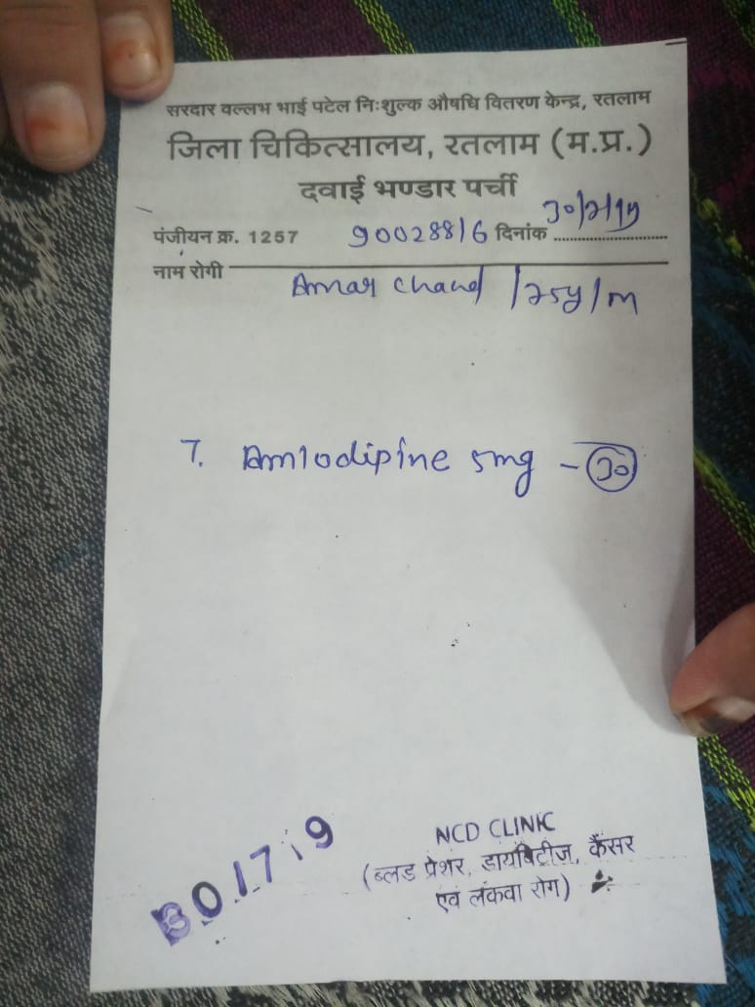
5. Documentation of patient follow up visit
Patients came for follow up, but not documented in treatment card
Local interventions such as stamping of NCD clinic, entry in OPD register along with BP

Slide 12
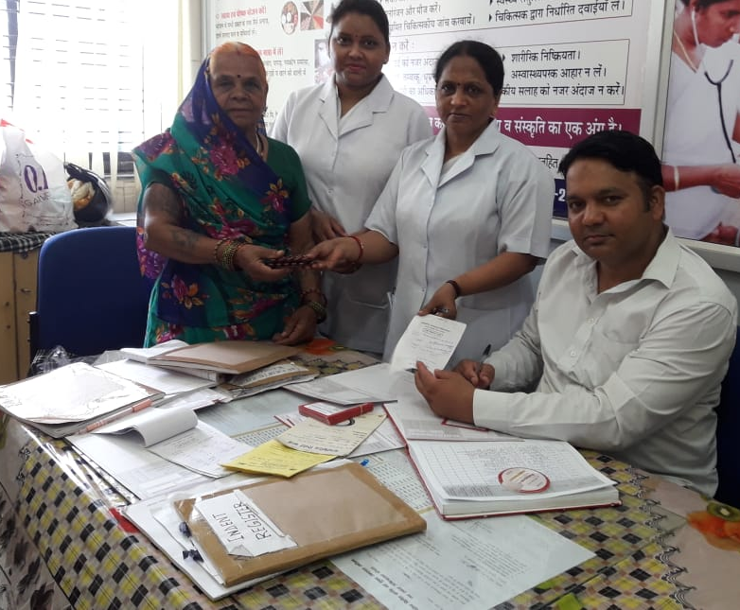
5. Documentation of patient follow up visit (Contd)
Initially drugs dispensed at pharmacy
After IHCI, drug distribution planned at NCD clinic by deputing one staff nurse
Missed visits reduced after intervention
Patients found it convenient to take drugs from NCD clinic directly
Documentation was improved

Slide 13
Strategies for identification
Notes:
Title finish

Slide 14
Key strategies for identifying missed visits
Two stack system of storage
Missed visit line list through SIMPLE app
Line list of missed visits

Slide 15
1. Two stack system of card storage
Cards of patients who have come for follow up in the lower row and cards of patients who are yet to come for follow up in upper row
Easy to implement and identify patients who missed visit
Cupboard/racks/box systems can be adopted

Slide 16
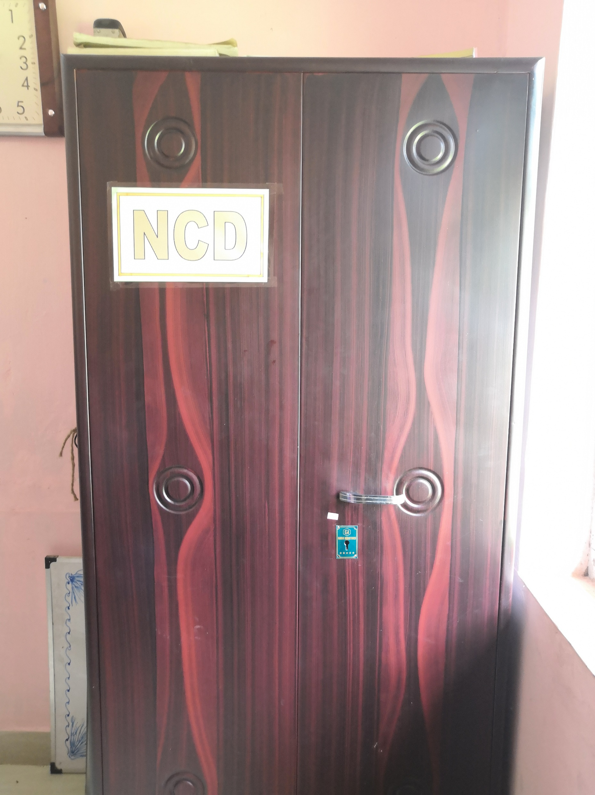
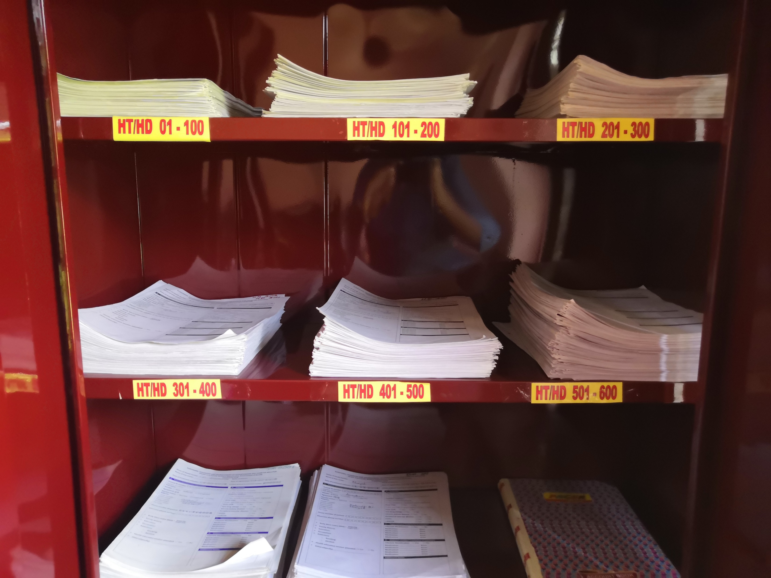
Examples of two stack systems

Slide 17
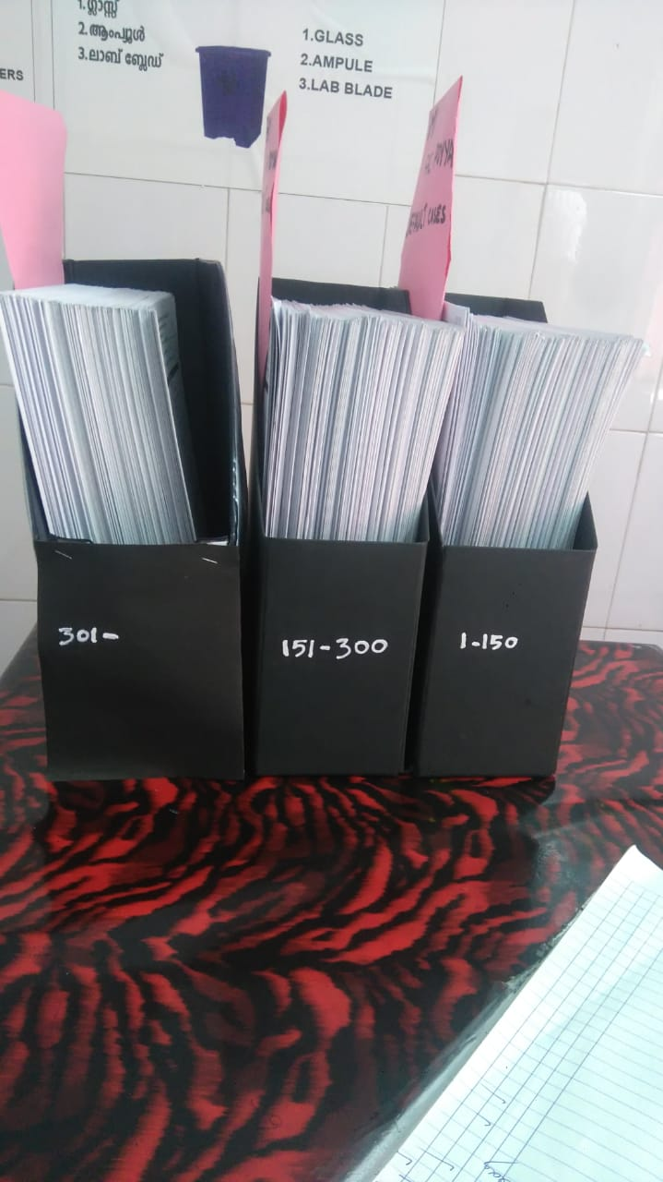
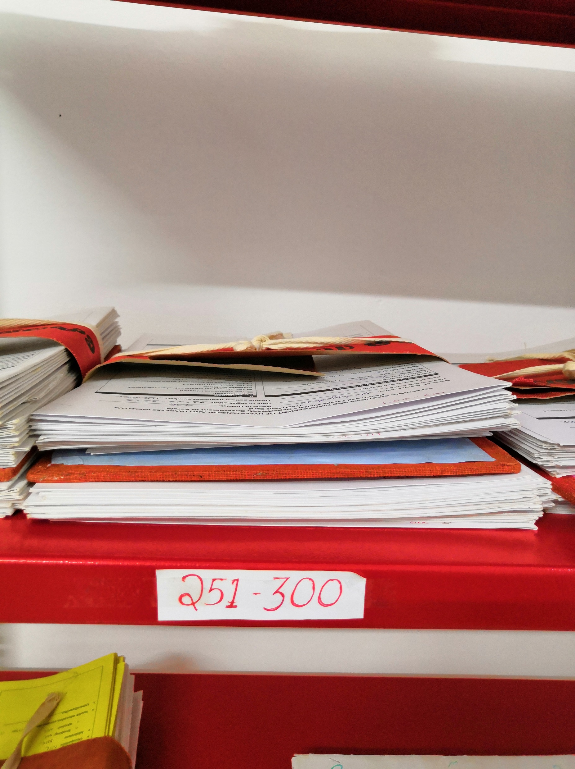
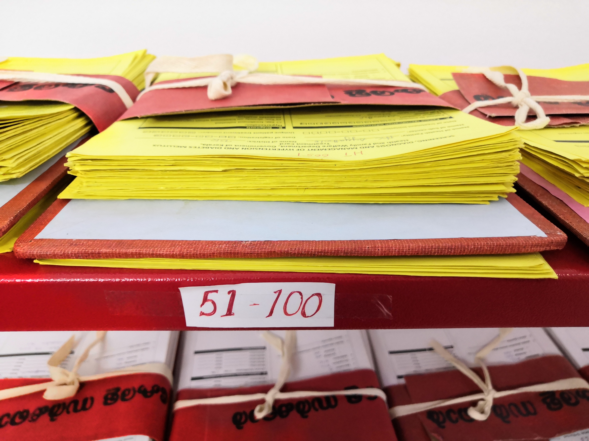
Examples of two stack systems
Not Visited during the month
Visited during the month

Slide 18
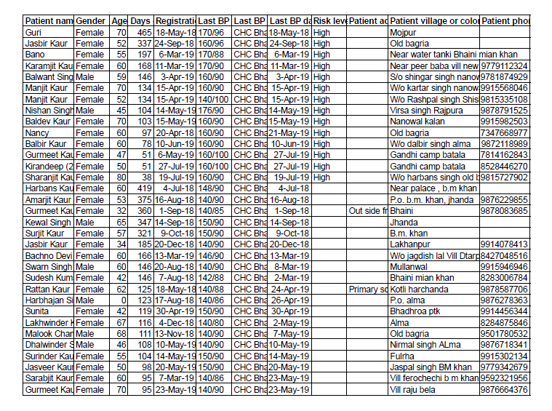
2. Missed visits patients identification through SIMPLE app
CVHO/MO extracts list of overdue patients from Simple app and gives it to STS/staff nurse
Staff nurse and field workers, segregate the patients village-wise
List of patients shared with ASHAs in monthly meeting or camps for retrieval of patients

Slide 19
3. Line list of missed visits
At the end of every month, staff nurse identified patients who missed their visits
Makes a line list of these patients Sub centre wise
Easier to share with ANM and review during monthly meeting about follow up

Slide 20
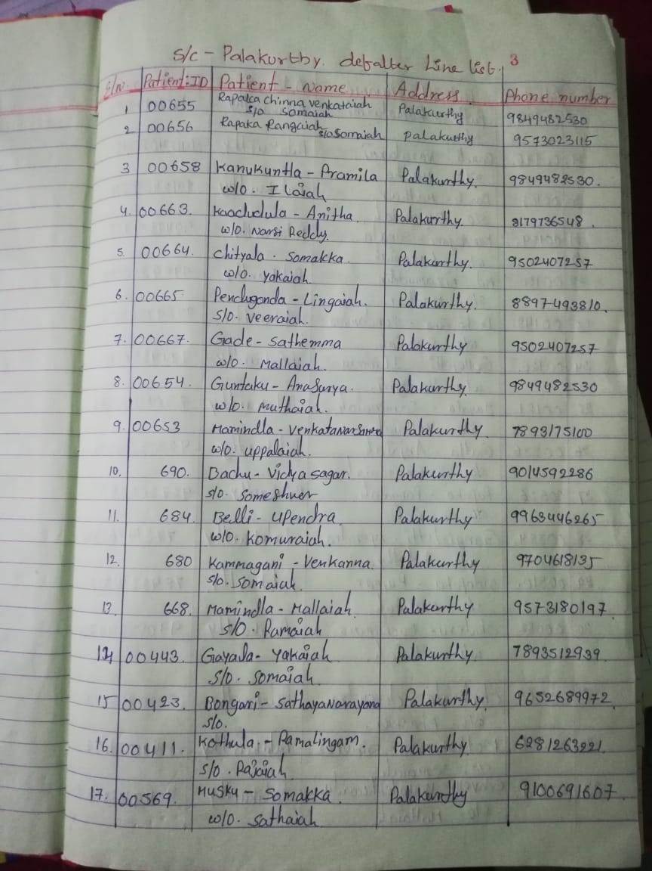
Line lists of missed visits patients by staff nurses
At a facility in State A
Follow up rate based on Quarterly report - 81%
(163/200)

Slide 21
Sample line list maintained at one Sub centre
Notes:
C-72/101- 71% and NUC – 21/101 – 21% and defaulters 8/101 – 8%

Slide 22
Strategies for retrieval

Slide 23
Key strategies for retrieval of missed visits/loss to follow up
Phone calls by staff nurses
Involvement of ANMs and ASHAs
Phone calls by Senior Treatment Supervisors

Slide 24
1. Phone calls by staff nurses
Missed visits patients identified through two stack system or follow up register
Staff nurses contact patient through phone call and counsel them to come for follow up
Response of the patient is noted down in the treatment card for future follow up and documentation
Details of non – responsive patients are shared with concerned with ANMs and ASHAs for house visits

Slide 25
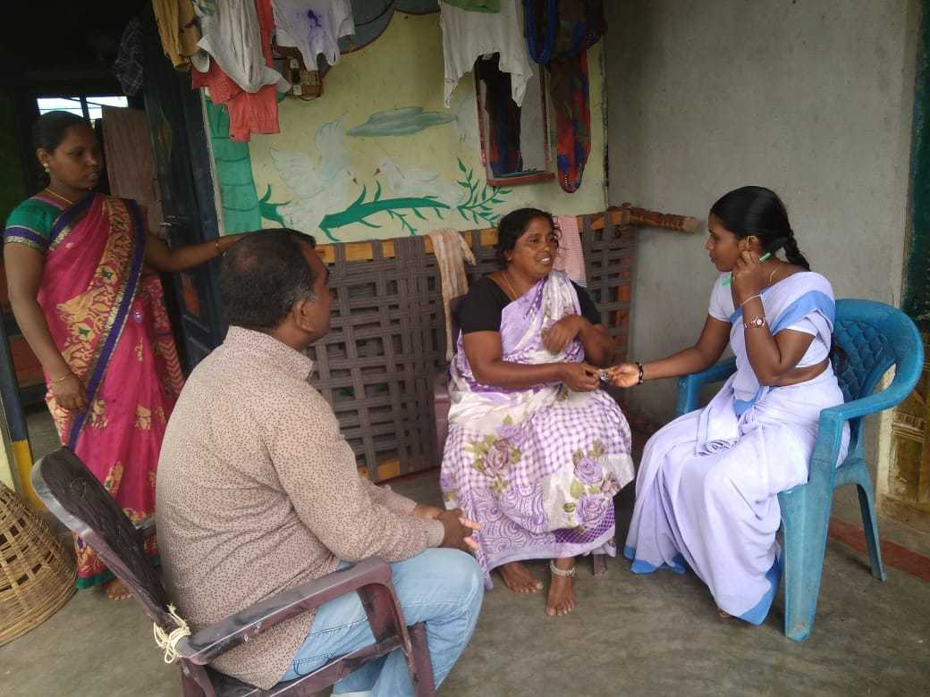
2. Involvement of ANMs and ASHAs in retrieval
Sub centre wise line list shared with concerned Supervisors and ANMs during monthly meetings (Ex: ASHA day or PHC review day)
ANMs circulate list to ASHAs
ASHAs make home visits to counsel patient to come for follow up
Patient contact through ANM and ASHA makes it easier to establish a long term rapport and trust

Slide 26
3. Phone calls by Senior Treatment Supervisors (STS)
During visits STS identify defaulters with BP > 160/100 mm Hg and call them for retrieval
In the process, staff nurse is also trained and motivated
For non – responsive cases, concerned ANMs/ASHAs are contacted by STS

Slide 27
Discussion

